Slide 1
Iron deficiency anemia detection using machine learning models
Link to paper

Slide 2
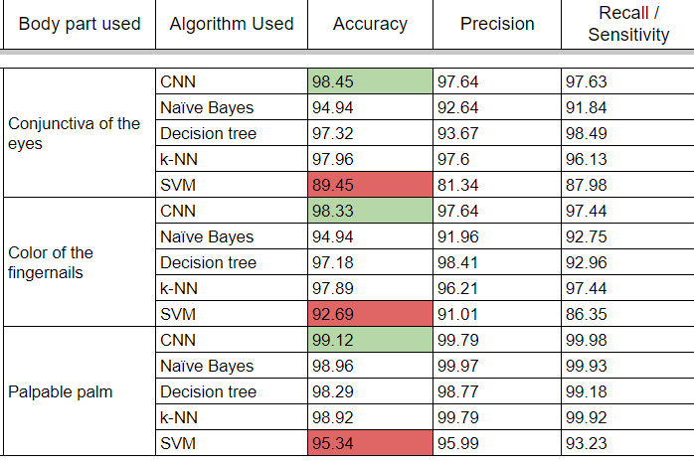
AIM
Conclusion
Compare Naïve Bayes, CNN, SVM, k-NN, and decision tree algorithms to detect iron-deficiency anemia
Compare the conjunctiva of the eyes, the palpable palm, and the color of the fingernail images to justify which of them has a higher accuracy for detecting anemia in children
The CNN achieved a higher accuracy of 99.12%, while the SVM had the least accuracy of 95.4%

Slide 3
Dataset
Why?
Preprocessing
Image Augmentation & Split
Used the largest publicly available dataset of 710 images for each class to assist in the development of machine learning models for the detection of iron deficiency anemia
since most studies used the conjunctiva of the eyes, this study compared the performance of the conjunctiva of the eyes, palpable palm and color of the fingernails in the detection of anemia
After the images were received through the database, they were extracted using the triangle thresholding algorithm
The pixels in each image were assigned to one of the three (CIE L*a*b* color spaces) segments according to their intensity levels.
With the application of the thresholding algorithm, each image was divided into three classes.
Each pixel of the image was then analyzed and the threshold value was applied to determine the color it should be categorized
For higher accuracy to be derived, machine learning models need to be trained on a large dataset. The small size of the dataset is capable of resulting in overfitting.
In the process of augmenting the images, the original datasets for each image, were rotated 90°, and 270°, flipped (mirrored/mirroring) and utilized a translation to the X and Y axis.
Afterwards a 70:10:20 split was done to the dataset

